Slide 1
ENRTY_RECORD_SYSTEM
Presented by:
Purvansh Singh

Slide 2
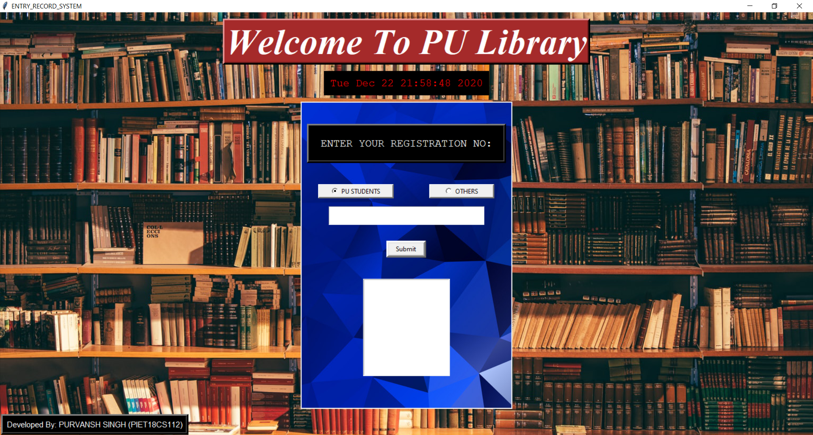
Entry Record System PU is a library entry record system designed on Tkinter, Python for Poornima University. It is programmed to ease the storage of student entries in the library. Admin would be able to access the list of students who entered the library with date and time.

Slide 3
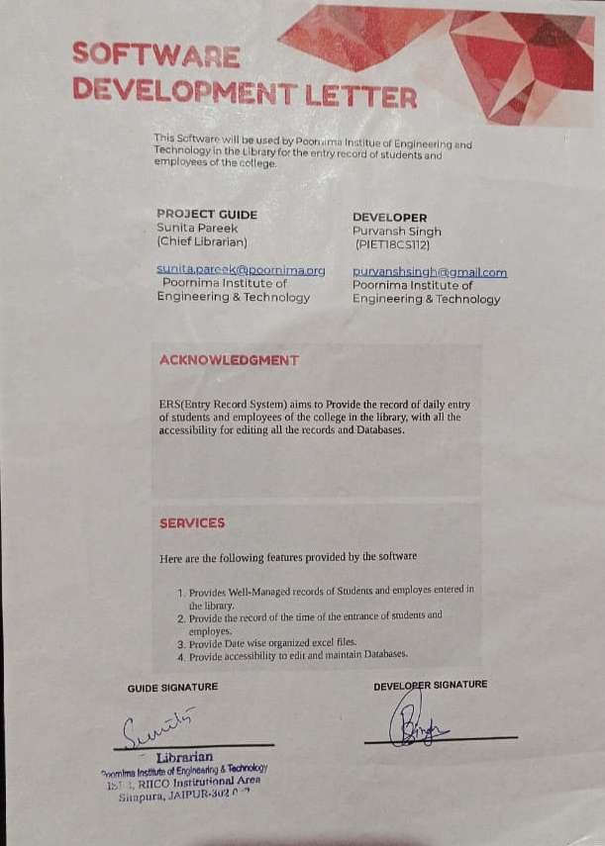
Development Letter

Slide 4
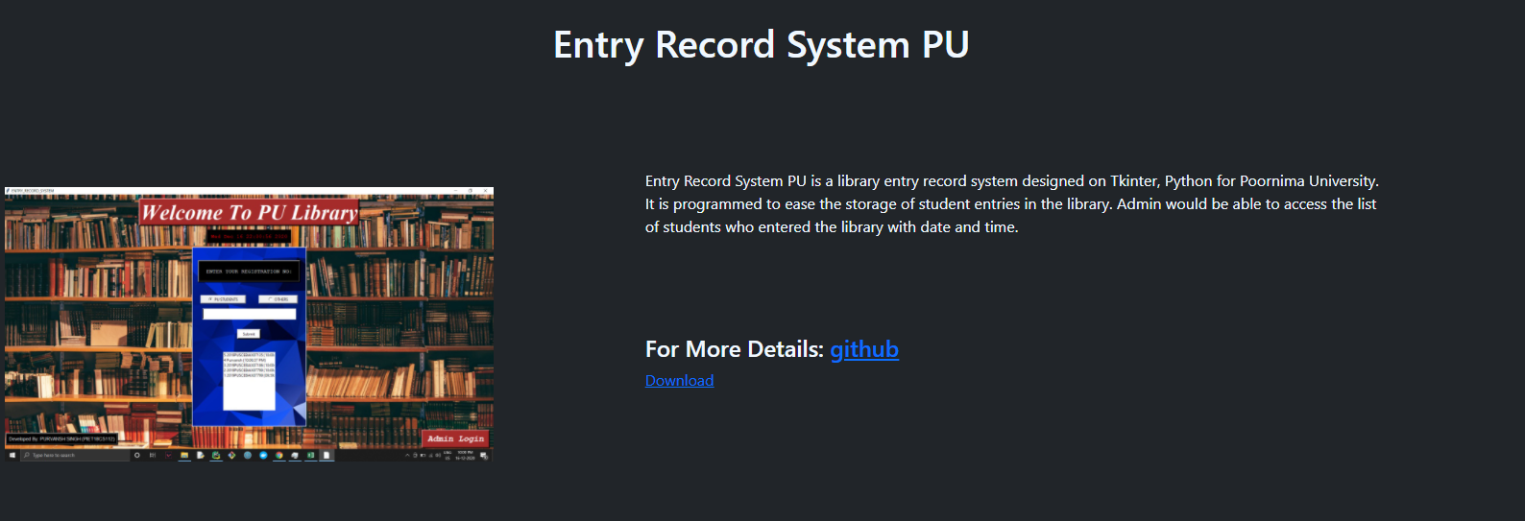
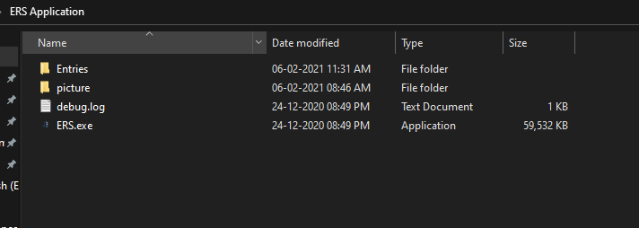
Simplicity

Slide 5
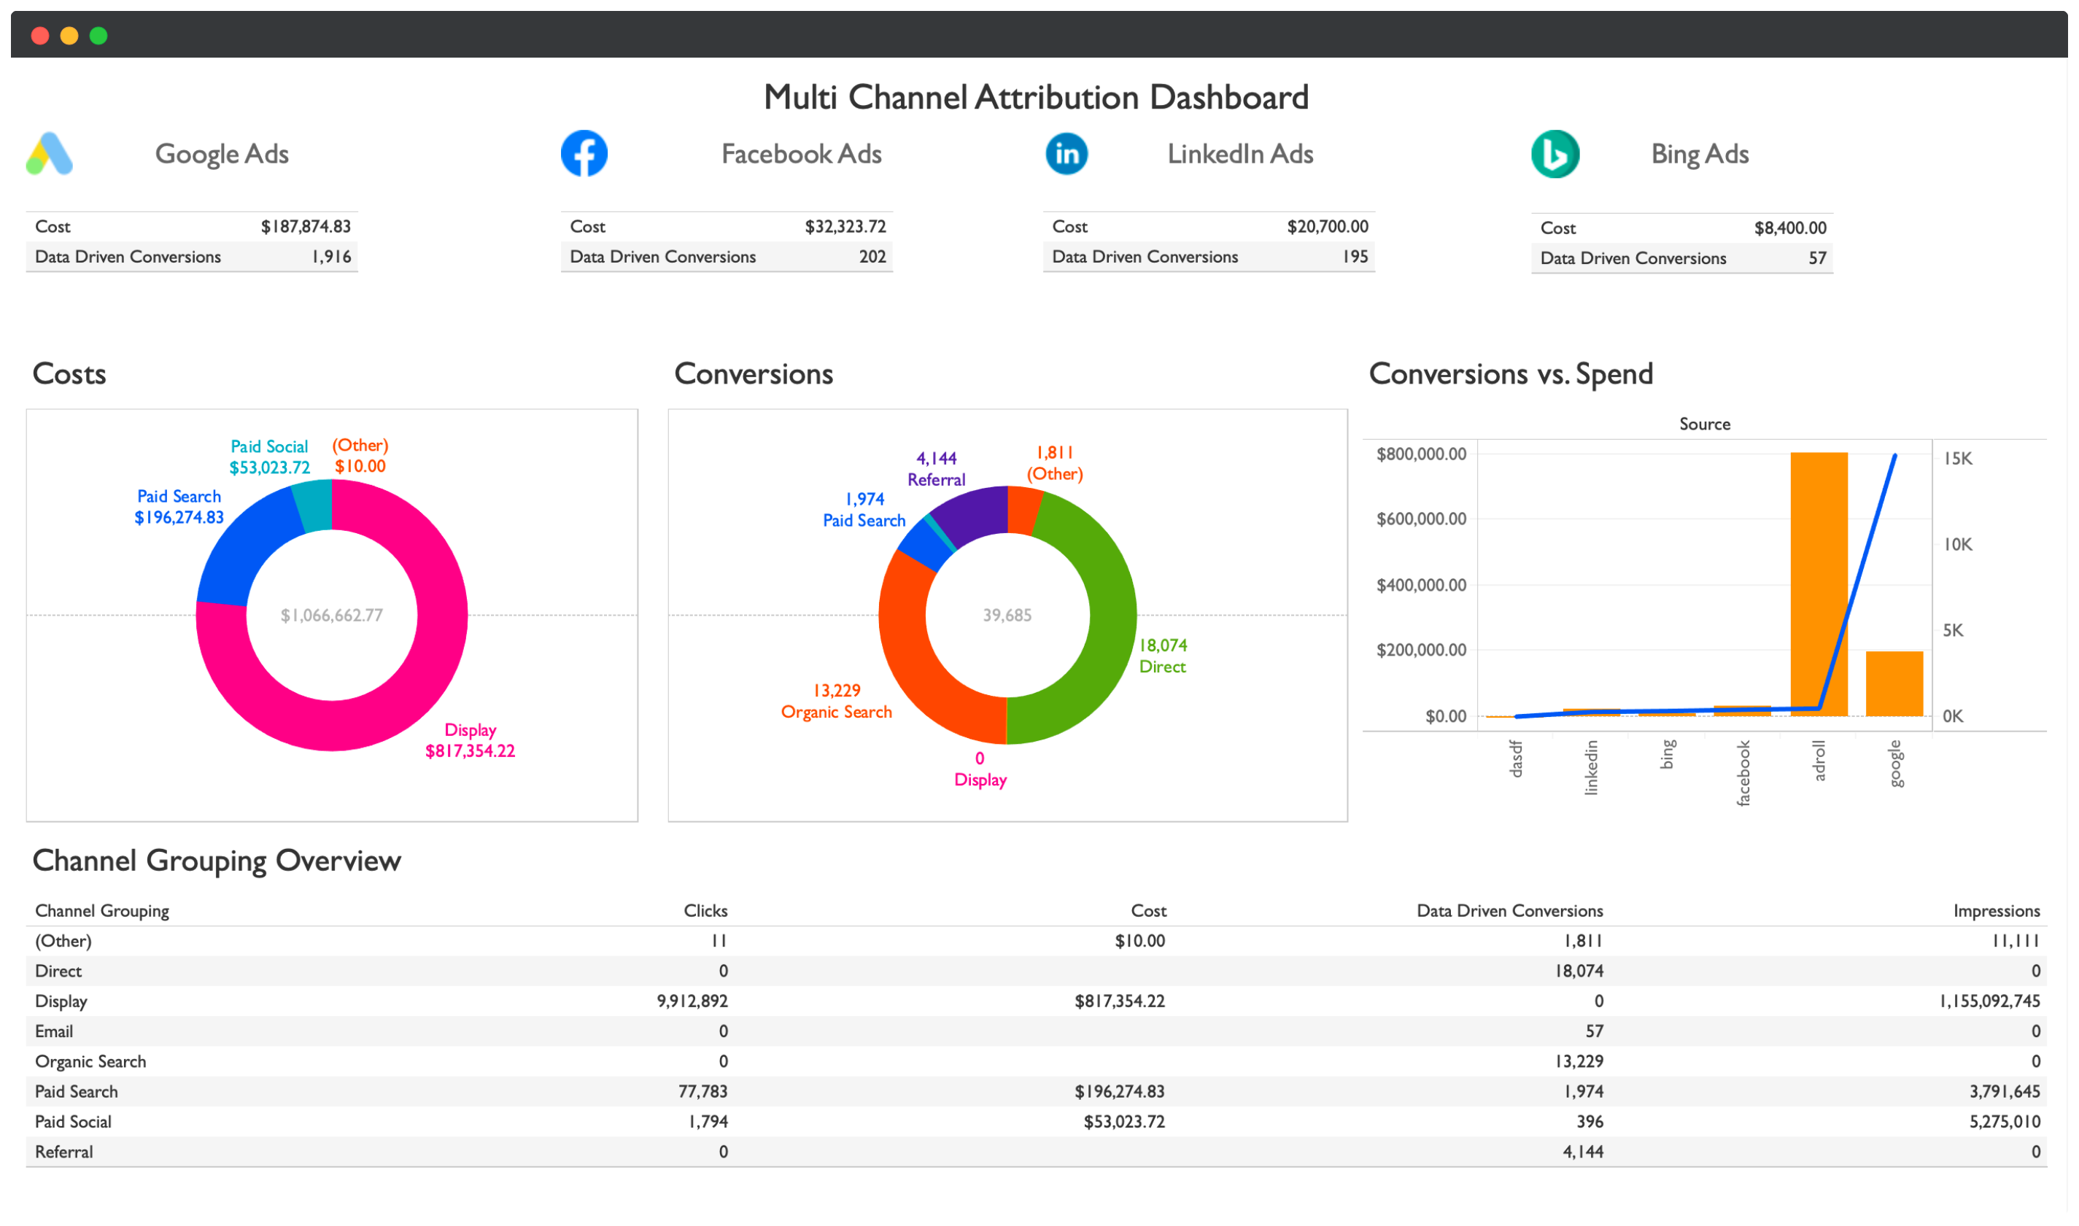



FUTURE ENHANCEMENTS

Slide 6
Thank you

